Slide 1
XPC Chart Review Simulator: Taking Flight
Morris Aguilar, Ph.D.
Generative AI (GenAI) Fellow at XPC
03-19-2025

Slide 2






Chart Review (CR) Prototype Road Map.
Markdown
Format
Prompts,
i.e., System
Prompt And
Patient Chart.
Local
Python Code
OpenAI
API
JSON
Format
Output
Local
Python Code
Browser
Ready
Document
*Associated files and code are in a private GitHub project repository.

Slide 3
Prompt Anatomy
Prompt Engineering Strategy | Description | Advantages
Writing the System Prompt in Markdown Format | The widely adopted Markdown format provides conventions for structuring plain-text. | Enhances LM interpretability of the relationship between human written instructions.
Defining Agent Role | Defining the norm of interactions and function of the agent. | Improves performance by aligning the agent to a domain, i.e., medical chart review.
In-Context Learning (ICL) | Description of task, requirements, and goals. | LM uses internal knowledge to understand the patterns and logic to generate the desired output.
Prune-and-Search | Listing specific topics include or exclude for consideration into final output. | Controlling the information that the agent considers to synthesize its final output more accurately.
Structured Output Formatting | A JSON output template provided in the system prompt. | Improves the usability and consistency of the outputs across SLMs for downstream processing.
Chain-of-Thought | Intermediate reasoning steps. | Breaks down the complex overarching task into simplified subtasks thereby improving performance.
Aguilar, MA, Abdullah, S. Open-Source Digital Scribe on Computationally Limited Hardware. Manuscript in Preparation for NeurIPS 2025.

Slide 4
CR Prompting.
Objective defined.
Instructions provided.
Guidelines listed.
Safety guardrails described.
JSON output format defined.

Slide 5
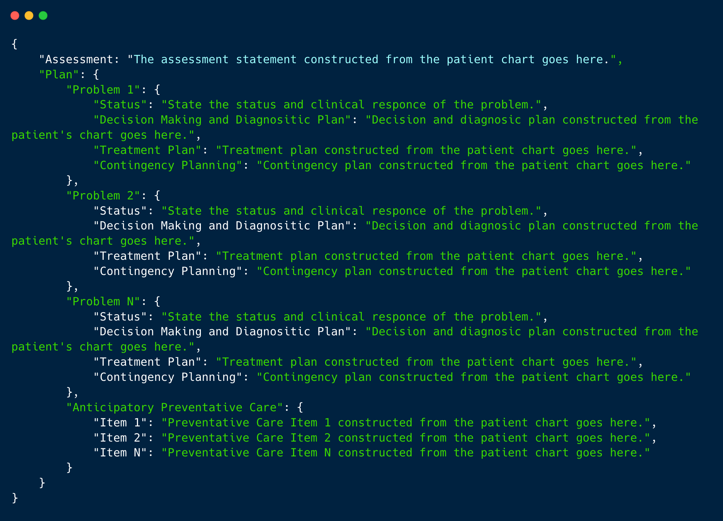
CR: Output is Standardized in JSON.

Slide 6
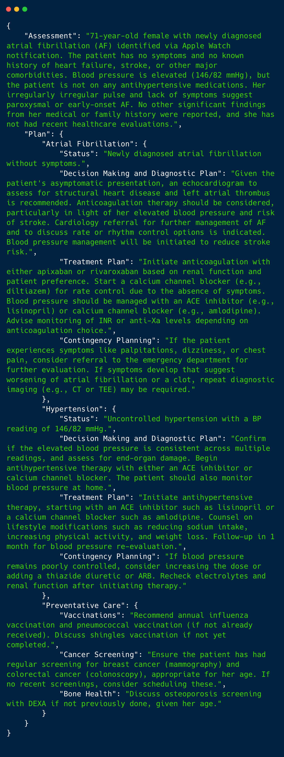
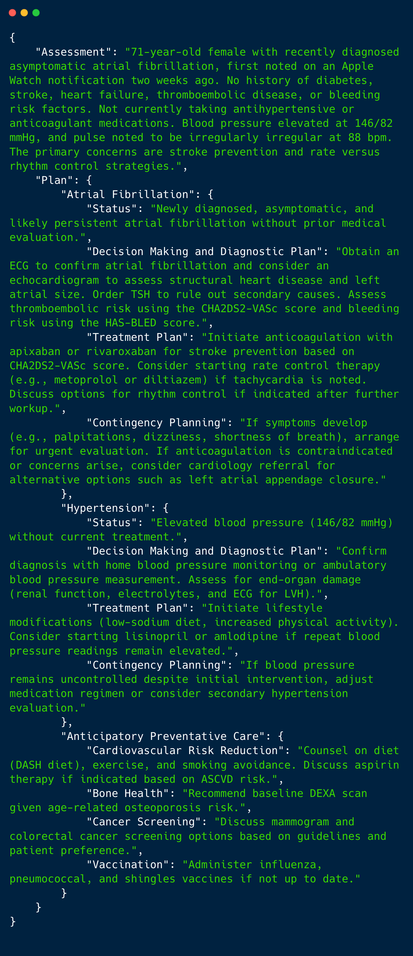
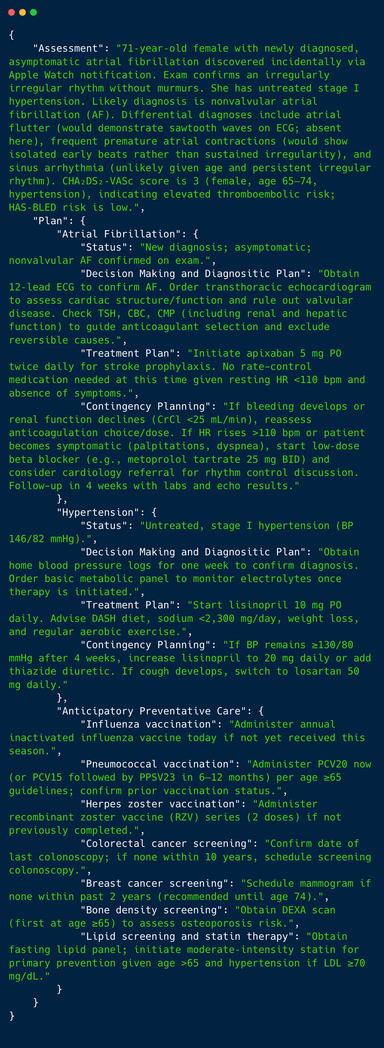
Assessment + Plan (cont’d on next slide.)
4o-mini
4o
o3-mini (reasoning model)
…
…
…

Slide 7
Preventative Care Outputs in same JSON.
…
…
…
4o-mini
4o
o3-mini (reasoning model)

Slide 8
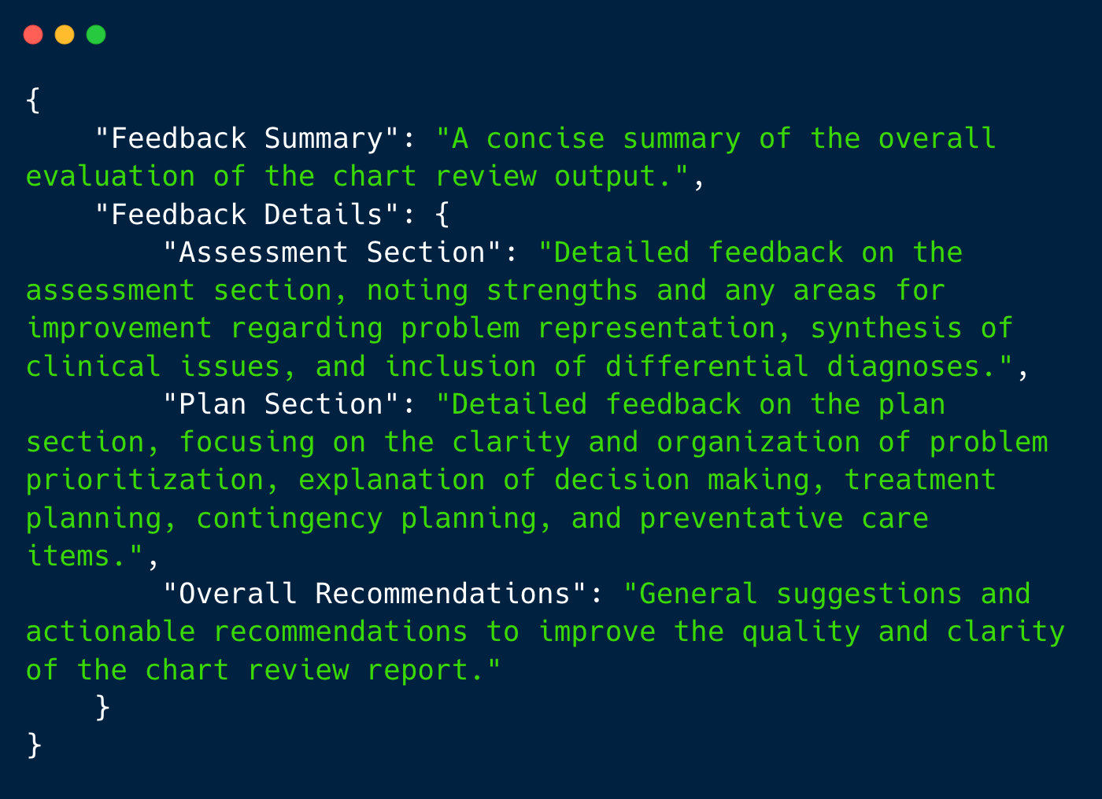
Prompt Chart Review Feedback JSON.

Slide 9
Feedback Workflow
Chart Review JSON Output
Feedback Agent
Feedback system prompt.
e.g.,
4o evals 4o CR,
o3-mini evals o3-mini CR.
Feedback JSON Output

Slide 10
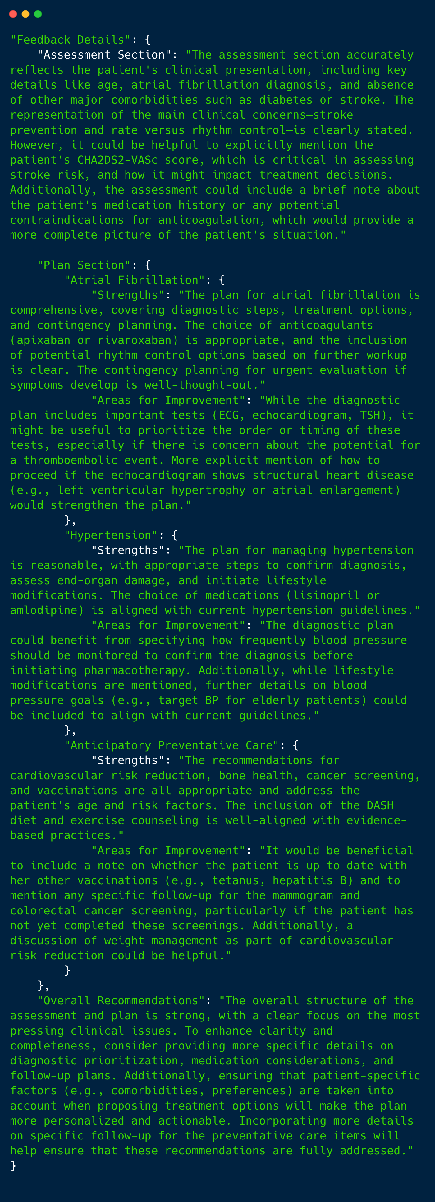
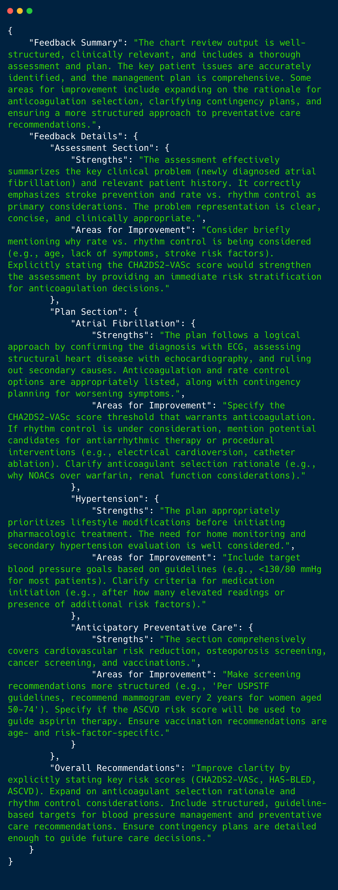
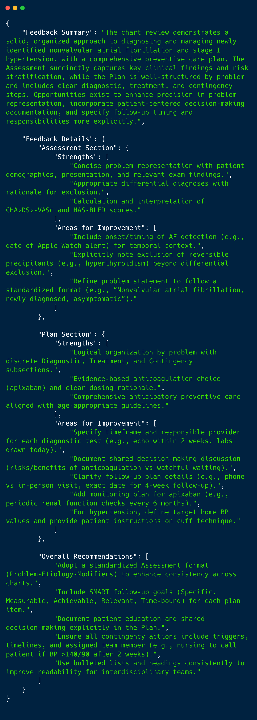
Chart Review Feedback Preview
4o-mini
4o
o3-mini (reasoning model)
…
…
…

Slide 11
Ideas to Consider for the Big Picture.
LLM Prompts as Intellectual Property.
Anthropic’s Anthology Fund
Focused on accelerating AI applications in areas including education and healthcare.
$25,000 in free Anthropic API credits.
XPC controlled LLM via AWS.

Slide 12

GenAI Self Sufficiency in the Near Future?
XPC AWS Infrastructure
Data and Privacy Controls
XPC
XPC
Local
Browser
Mistral AI*
Example
Model
JSON
Format
Output
Local
Browser
* Mistral AI is one option out of several models open-source models that can be fully controlled in AWS.

Slide 13
Practical Next Steps:
Beyond OpenAI models
Anthropic
Mistral
LLaMA
Possible Future Directions
Interfacing the computational pipeline with:
U.S. Prevention Task Force API.
Standardized medication name retrieval.
E.g., SciSpaCy for named entity recognition.
Retrieving the latest medication prices from a data base.
Notes:
Kroger and walmet med list
Prompt for plan and assemtn
User preference (van Neen Paper) prompt benchmarking (sciSpaCy) next meeting
Adding new synthetic patients.
Parsing the html into a prompt (needs to call labs)

Slide 14
Clarifying Questions.
Items missing or recommended for the final output(s)?
Order items in the final output?
Social determinants of health.
Health maintenance items.

